Slide 1
Day 3 and 4
4) Conditional Statements:
What are conditional statements
The if statement
If and else statement
If elif and else statement
Quiz and Exercise
5) Python Loops:
What are loops
The while loop
The for loop
The nested for loop
Break, continue and pass
Quiz and Exercise

Slide 2
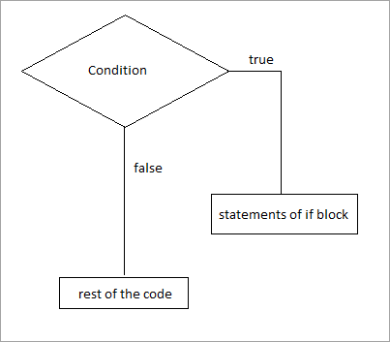
Conditional Statements in Python
What are Conditional Statements :
Conditional Statement in Python perform different computations or actions depending on whether a specific Boolean constraint evaluates to true or false. Conditional statements are handled by IF statements in Python.
IF Condition :

Slide 3
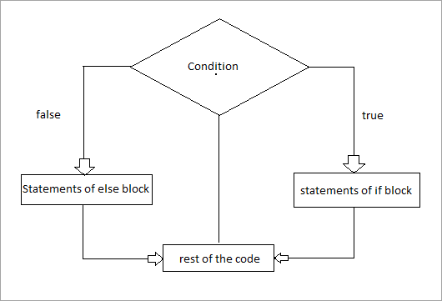
Else Condition:
Else block will execute only when the condition becomes false, this is the block where you will perform some actions when the condition is not true.

Slide 4
Elif Condition:
Elif statement is used to check multiple conditions only if the given if condition is false. It's similar to an if-else statement and the only difference is that in else we will not check the condition but in elif we will do check the condition.
Syntax:
if (condition):
#Set of statement to execute if condition is true
elif (condition):
#Set of statements to be executed when if condition is false and elif condition is true
else:
#Set of statement to be executed when both if and elif conditions are false

Slide 5
Nested if else statement :
Nested if-else statements mean that an if statement or if-else statement is present inside another if or if-else block. Python provides this feature as well, this in turn will help us to check multiple conditions in a given program.
Syntax:
if(condition):
#Statements to execute if condition is true
if(condition):
#Statements to execute if condition is true
#end of nested if
#end of if

Slide 6
Python Loops
Python programming language provides following types of loops to handle looping requirements. Python provides three ways for executing the loops. While all the ways provide similar basic functionality, they differ in their syntax and condition checking time.
1) While Loop:
In python, while loop is used to execute a block of statements repeatedly until a given a condition is satisfied. And when the condition becomes false, the line immediately after the loop in program is executed.
Syntax :
while expression:
statement(s)
Using else statement with while loops:
The else clause is only executed when your while condition becomes false. If you break out of the loop, or if an exception is raised, it won’t be executed.

Slide 7
Syntax:
while condition:
# execute these statements
else:
# execute these statements
2) For Loops:
A for loop is used to iterate over a dataset.
Syntax:
for iterator_var in sequence:
statements(s)
3) Nested Loops:
Python also supports loop inside another loop, this is called as the nested loops.

Slide 8
Exercises:
1) Print in proper format ' print letters in correct format '
2) create a list name desserts holding two values 'ice-cream','cookies'
3) sort desserts in alphabetical order
4) display the index of the ice-cream
5) copy the contents of the desserts in other list called object
6) remove cookies from desserts.

Slide 9
Conditional Statements:
Program to find the greater number between the two.
Program that takes user input and identifies even and odd number
Program to identify a valid mobile number
define a function that takes list of numbers as argument and output the number that are less than 20
Count the number of letters in refrigerator without using len() function.
find the length of each element of array
print the number of vowels occuring in ‘refrigerator’
Write a program to find the number of vowels, consonents, digits and white space characters in a string. 'I am learning python'
Print all letters except ‘E’ in cricket.
Write a program to make a new string with all the vowels deleted from the string "Hello, have a good day" (output : Hll, hv gd dy)
Write a program to find out the largest and smallest word in the string "This is python programming".
Write a program to check if a given string is a Palindrome. A palindrome reads same from front and back e.g.- aba, ccaacc, mom, etc.
a = ['read','feed','string',’at’] , Write a Python program to add 'ing' at the end of a given string (length should be at least 3). If the given string already ends with 'ing' then add 'ly' instead. If the string length of the given string is less than 3, leave it unchanged.

Slide 10
14 Write a Python program to count the number of even and odd numbers from a series of numbers. [15,13,17,19,14,6,61,62]
Form a pattern
*
**
***
****
*****
****
***
**
*
16 Form a pattern:
*
***
*****
***
*
17 Identify a fibnocci series (1,1,2,3,5,8,13….)
18 Identify a prime number in range (2,30)

Slide 11
19. write a program to calculate the average of a list of numbers
[1,2,3,4,5,6,7,8,9,10]
20. Print the multiplication table of 7 as (7*1=7 and so on)
21 Factorial of any number n is represented by n! and is equal to 1*2*3…..(n-1)*n. Write a program to calculate factorial of a number.
22. Three digit number is called Armstrong number if sum of cube of its digit is equal to number itself. E.g.- 153 is an Armstrong number because (1³)+(5³)+(3³) = 153. Write all Armstrong numbers between 100 to 500.
23. Write a Python program to find the median of given values
[8,10,15,20,11,17,30,22,13,16,23]
24 write a program to print patter 0 as :
***
* *
* *
* *
* *
* *
***
25. Write a program that gives a list of elements which is reversed for eg:
['string','integer','float','boolean'] output as : ['gnirts', 'regetni', 'taolf', 'naeloob']

Slide 12
1) For finding the prime number :
>>> for n in range(2, 10):
... for x in range(2, n):
... if n % x == 0:
... print(n, 'equals', x, '*', n//x)
... break
... else:
... # loop fell through without finding a factor
... print(n, 'is a prime number')
2) print 10 intregers using for loop
3) Using For loop print the length of each element.
4) Using for loop find whether the integer is even or odd.
5) Using for loop print the fibnocci series.

Slide 13
Code to check whether the number entered by the user is greater than or less than 100
https://docs.python.org/3/tutorial/controlflow.html
https://www.geeksforgeeks.org/loops-in-python/

